Slide 1
ciSalon App
Jasmine Morgan, Bryce Pittman, Van Hamlin, Dylan Goodwin
CIS 330: System Analysis and Design
Dr. Davis
22 Apr. 2025

Slide 2
Problem Statement
Most salons use personal apps to schedule appointments or none at all.
Customers struggle to tell if the salon is good.
Booking for beginning salons can be frustrating, inefficient, and unreliable.
Many scheduling systems are expensive.
Notes:
Most salons use personal apps to schedule appointments or none at all. Customers struggle to efficiently tell if the salon is good because generally there are no reviews or service photos on the salon being used. Booking for beginning salons can use word-of-mouth or paper booking, which can be frustrating, inefficient, and unreliable. Most local salons struggle to make appointments with consumers with a scheduling system that has an affordable cost. Local salons in our area face challenges with scheduling due to the high cost and limited functionality of existing scheduling platforms, which fail to meet their specific business needs. This creates inefficiencies and frustrations for salon owners and their clients.

Slide 3
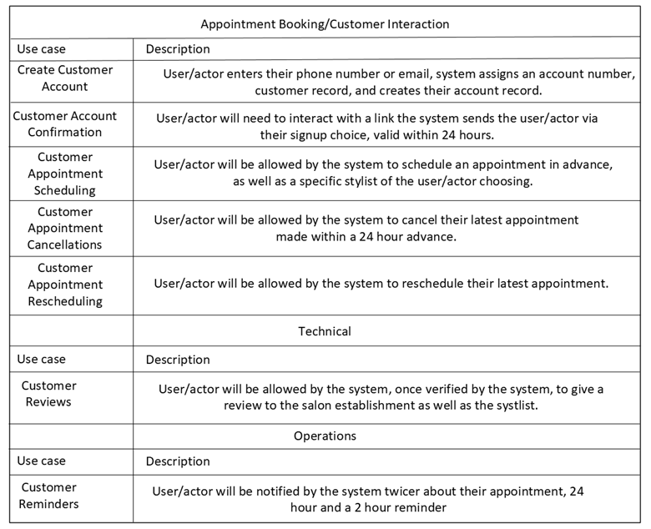
Feasibility Study
The final product will be successful for the following reasons:
Verification improves sign-up security.
Scheduling/canceling appointments help things run smoothly.
Using customer data will help prevent busy/down times
Notes:
Verifying the email/phone number improves sign-up security.
The ability to schedule/cancel appointments effortlessly will allow busy days to run smoothly without too much error.
Using customer data effectively will allow the system to know popular scheduling times, available employees, and the salon schedule. Which will help prevent busy and down times.

Slide 4
Requirements Analysis & Specification
System Requirements
The subsystem shall make bookings to allow customers to make an appointment.
The subsystem shall allow scaling with the number of clients.
The subsystem shall allow bonuses if the barber gets good reviews based on customers.
The subsystem shall be able to segment between cancellations bookings and missed appointments.
The subsystem shall allow users to reschedule appointments.
The subsystem should allow a chat within the app to allow customers to talk directly to their stylists and vice versa making it easier to be all in one.
The subsystem shall not allow a full refund within 30 minutes of the appointment time.
The subsystem should allow a tier loyalty list to allow customers to get prizes, free haircuts, and 10% off of products.
The subsystem shall allow customers to sign up with a phone number and email which can be optional.
The subsystem shall send a confirmation via text/email to the user.
The subsystem shall allow booking with the intended stylist.

Slide 5
Requirements Analysis & Specification
Technical Requirements
The subsystem shall allow customer reviews for the salon and stylists to gain more credibility.
The subsystem shall verify customer reviews and their authenticity.
The subsystem should not allow fake or fraudulent reviews to be submitted. It should allow measures to detect and flag suspicious activity, it should also prevent reviews before an appointment has been concluded.
The subsystem should allow salon owners to respond to customer reviews, creating a more dynamic feedback loop that includes communication and improvement.
The subsystem shall create an average review based on the total reviews from the users.
The subsystem should prompt customers to leave a review after their appointment via notification.

Slide 6
Requirements Analysis & Specification
Legal Requirements
The subsystem shall include a Terms of Service & Privacy Policy.
The subsystem shall have a liability section to protect individuals if something were to occur within the salon.
Operational Requirements
The subsystem shall include a 24-hour reminder and an additional 2-hour notice.
The subsystem should include the ability for users to check in for their scheduled appointment when they arrive at the salon.
The subsystem should give the user an estimated wait time once the user has checked in to the salon.
The subsystem should notify salon staff when a user checks in for their appointment and when the user is approaching the scheduled time.
The subsystem shall allow users to be notified if their appointment has been delayed or rescheduled.
The subsystem shall allow users to view past appointments including services provided.
The subsystem should allow salon owners to set and update business hours and stylists' availability during time slots.
The subsystem shall hold data for a month and if user inactivity is detected their data will be deleted from the subsystem.

Slide 7
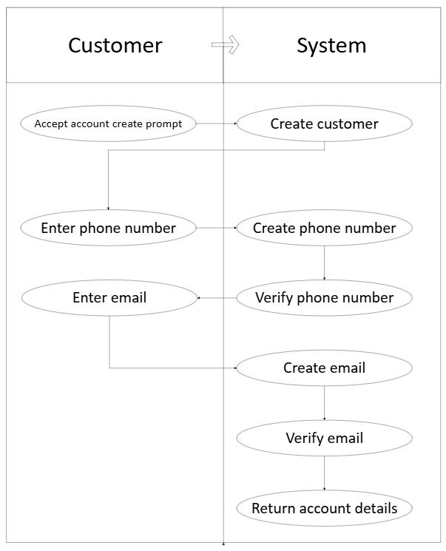
Preliminary Design
The user will:
Accept the account create prompt
Enter a phone number
Enter an email address
The system will:
Create the customer in its database
Create & verify the phone number
Create & verify the email
Return account details to the user

Slide 8
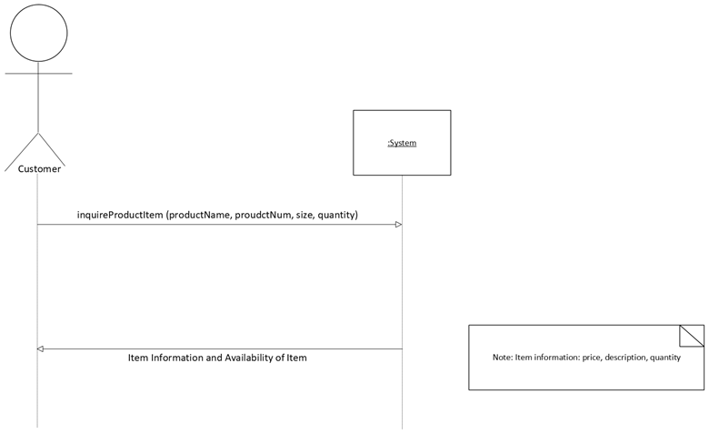
Detailed Design

Slide 9
Detailed Design
Modify / Cancel
Appointment
Sign-up / Log-in
Dashboard
Select Appointment
Choose Service / Date
Appointment Confirmed
Log Out

Slide 10
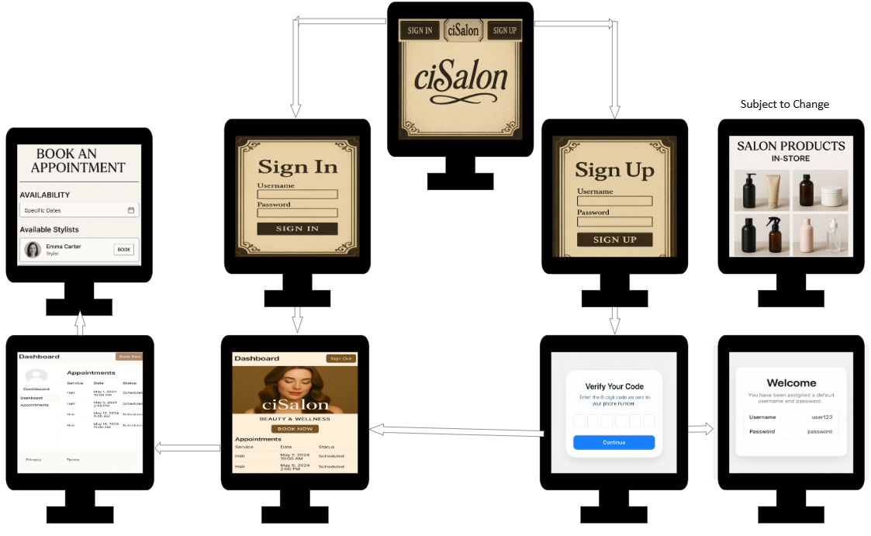
Detailed Design

Slide 11
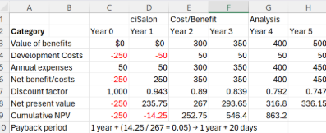
Project Management

Slide 12
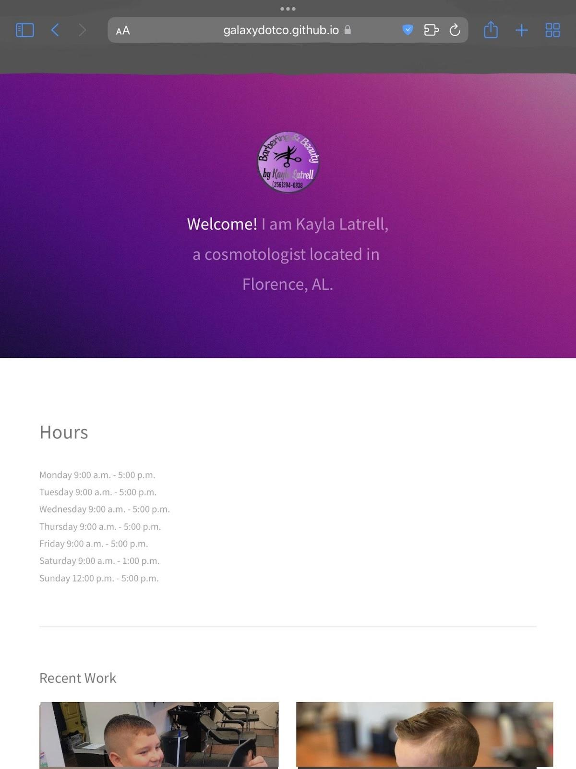
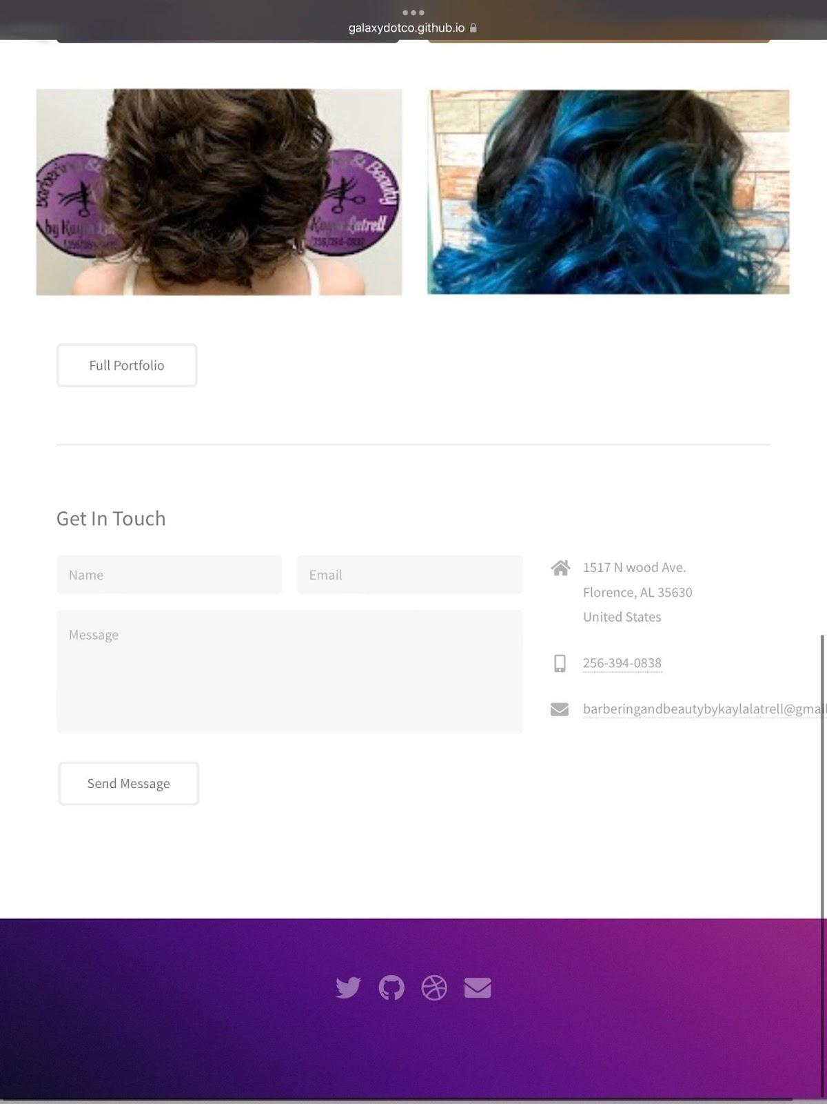
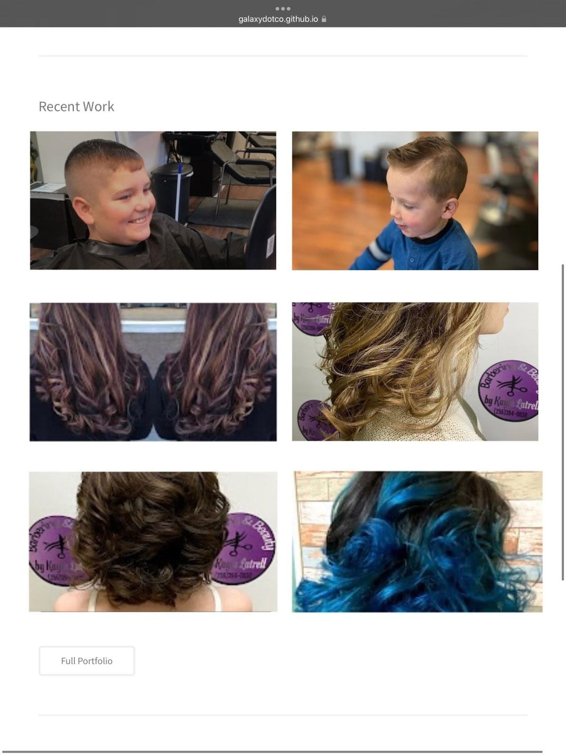
Working Prototype

Slide 13
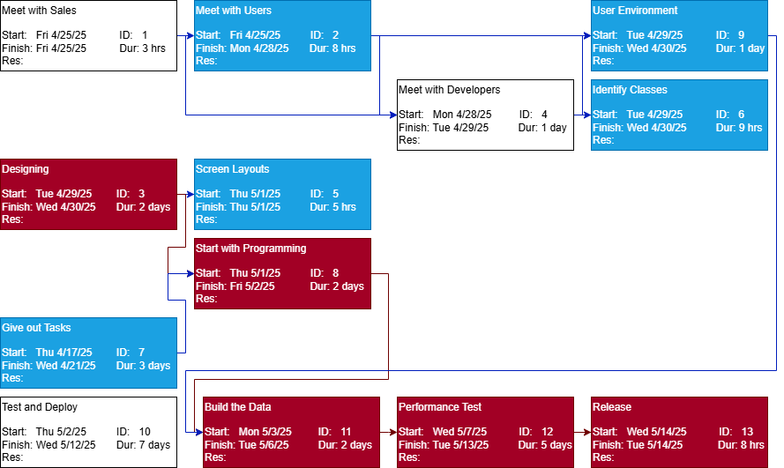
PERT Chart

Slide 14
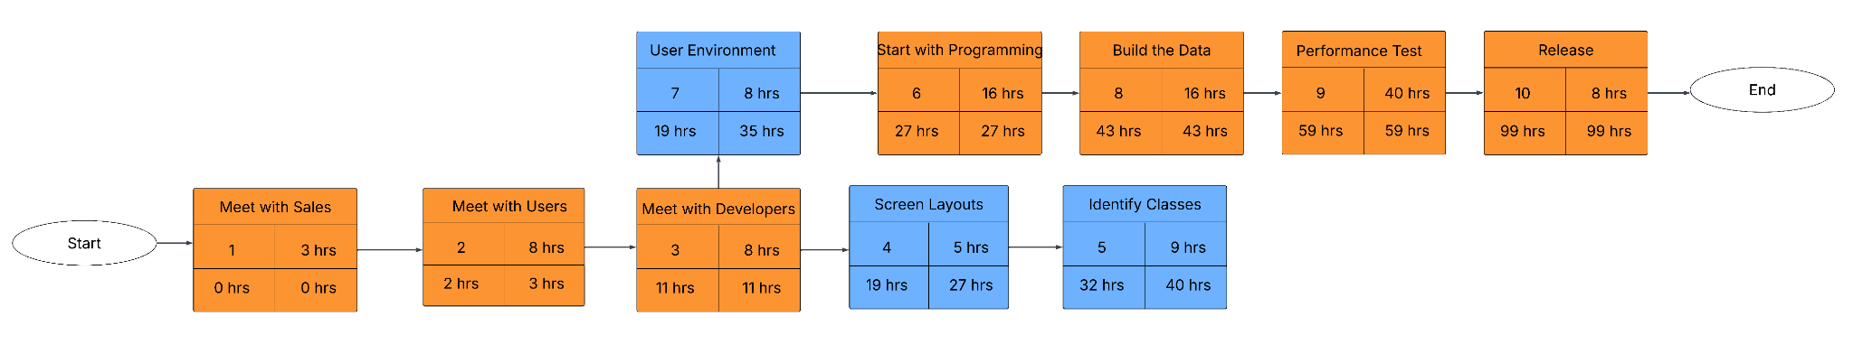
CPM Chart

Slide 15
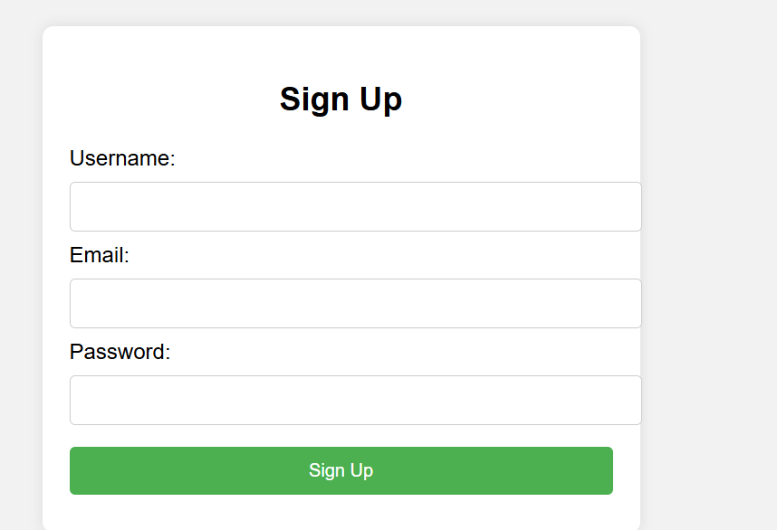
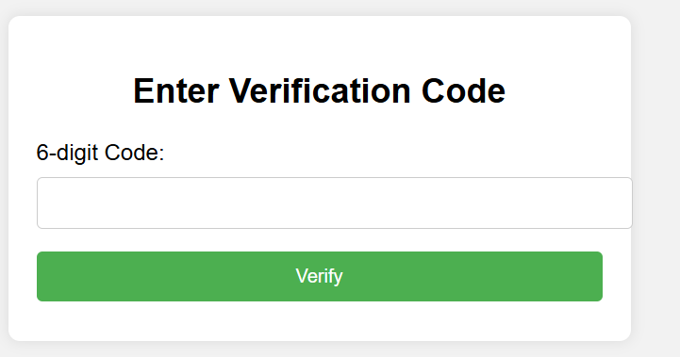
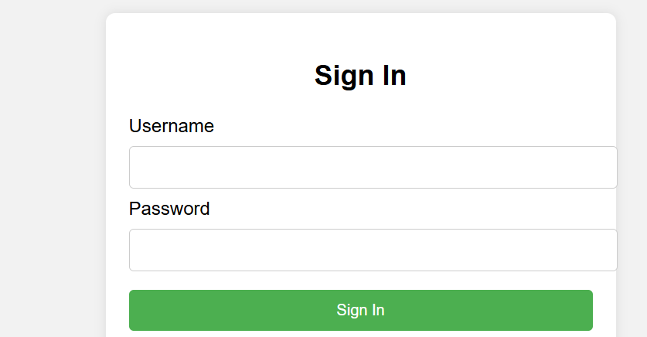
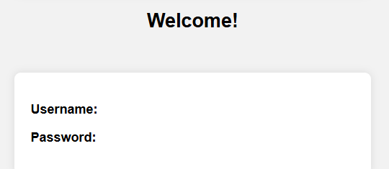
Mockup

Slide 16
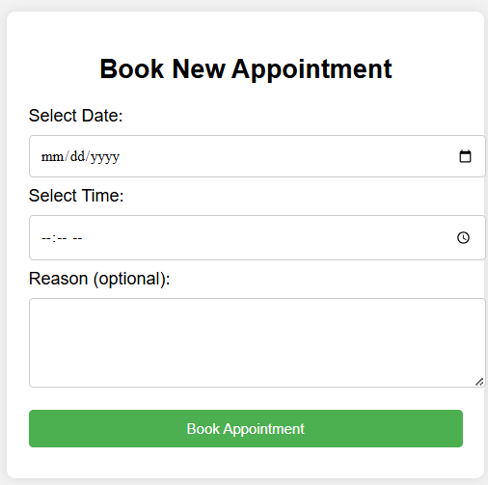
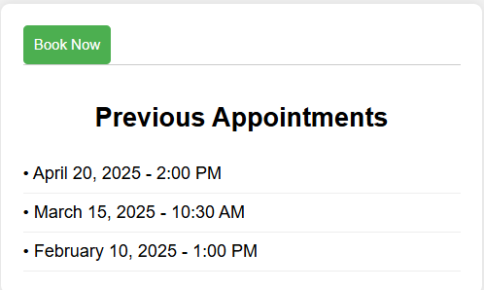
Mockup (continued)

Slide 17
Conclusion/Wrap Up
Notes:
Reiterate what was said so far.

